Slide 1
Blockchain
Development Environment
Date: September 26, 2017

Slide 2
Blockchain Environment Setup
Development and test environment for Blockchain
On premises workstations setup
Dev and Test Labs in cloud
- This option will take a long time to set-up
1
2
Azure Dev and Test Lab
AWS Dev and Test Environment in VPC
Based on prior discussions, dev and test labs in cloud option is recommended.
One of the two options may be chosen based on availability/feasibility

Slide 3
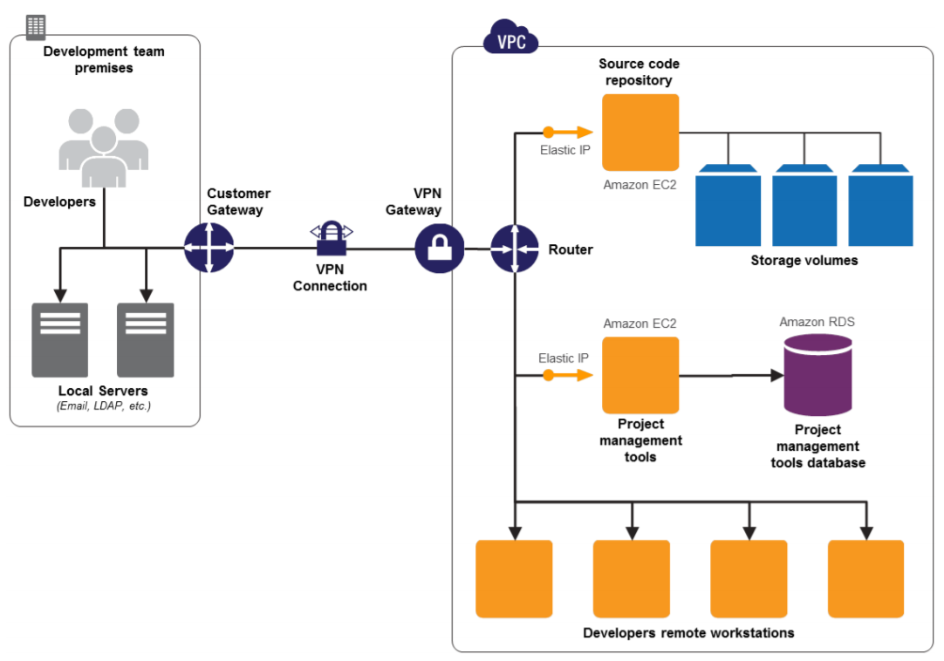
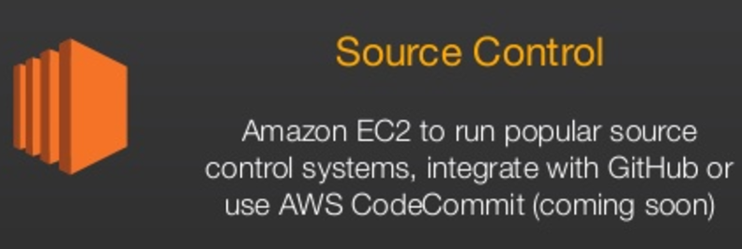
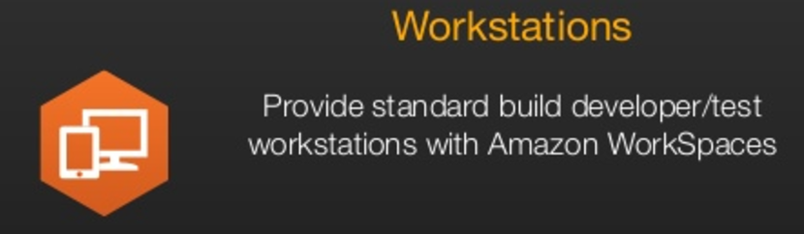
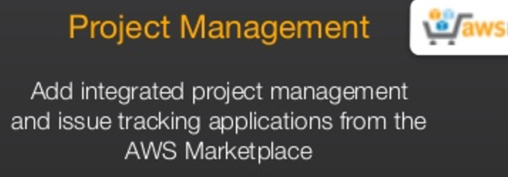
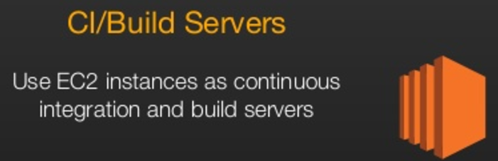
Option 1: AWS Dev and Test Environment in VPC
Features of AWS VPC
Set-up Amazon Virtual Private Cloud (Amazon VPC)
Lets you extend your on-premise private network to the cloud
Allows one to provision the development environments as if they were on the local network, but instead they are running in AWS.
This can be helpful if such environments require any on-premise resources (such as LDAP)

Slide 4
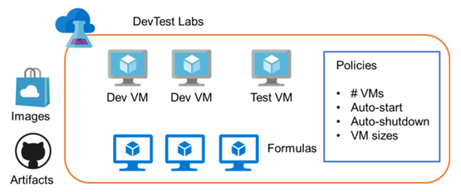
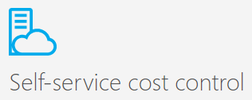
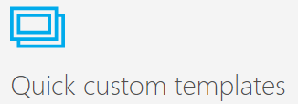
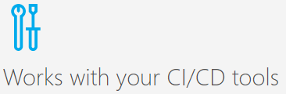
Option 2: Azure Dev and Test Lab
Labs enable you to set policies for the lab to manage costs and minimize waste. You can set things like the number of VMs that each person can use, the allowed VM sizes, auto-shutdown and startup times for VMs and more.
VMs are based on images that can come from the readily available with the cloud provider or that you upload yourself, these contains the operating systems like Windows and Ubuntu or any specific server with additional major platform products
VMs can contain artifacts. These can be things that need to be installed, but also things that need to happen, like GIT
When you create a VM, you choose the properties of the VM like the base image, the name, the size (pricing tier), the disk type, etc. In Azure DevTest Labs, you can create formulas that allow you to create a VM quickly
Features of Azure Dev Test Lab

Slide 5



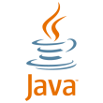







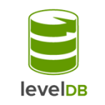

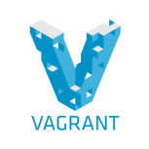
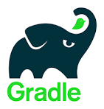

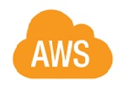
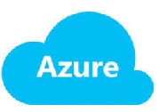
Blockchain Technology Stack
 | Hyperledger-Fabric | R3-Corda
UI / DApp
API / Services
DLT/Blockchain Platform
Smart Contract
Ledger/ Store
Compile/Build
Package
Deploy

Slide 6
Development Platforms and Toolset
 | Hyperledger-Fabric | R3-Corda
OS | Ubuntu Desktop | Windows / Ubuntu Desktop
SCM | GIT | GIT
IDEs | Eclipse-Mars ATOM, VS Code | IntelliJ
Lang/ Frameworks | Fabric 1.0 GO Lang | Corda-0.14 Kotlin
Common frameworks and tools | JDK2.8.31, Spring, AngularJS, BootStrap, Postman, Junit, Mockito, Cucumber, GitBash CLI
Dev Tools | Fabric-Composer, Fabric Playground Node, NPM , Python 2.7 Yeoman, Mocha/Chai, JSLint, ESLint | Korda DSL
Compile / Build | Gradle, NPM | Gradle
Package | Docker | Docker
Deploy | AWS/Azure
Agile/ALM Tools/DevOps | JIRA, Jenkins
Development VMs in the cloud would need to be setup with either the Hyperleger Fabric or R3 Corda platform and mentioned specifications along with VMs for common servers

